Slide 1
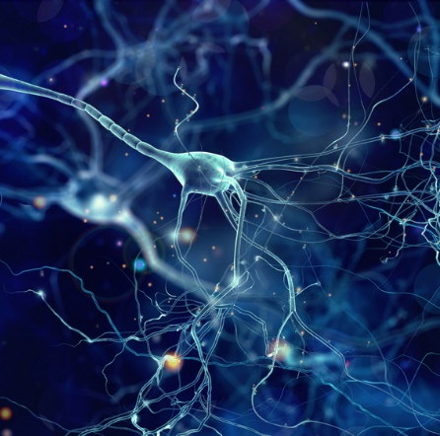
Beauty Camera
R36104188 工資所 王敬傑

Slide 2
CONTENTS
01
02
03
04
Contrast
Sharpen
Denoise
Deblur

Slide 3
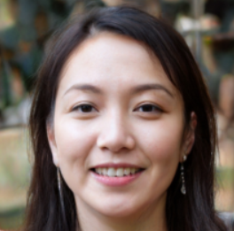
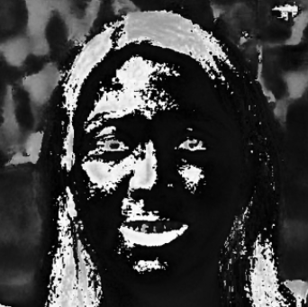
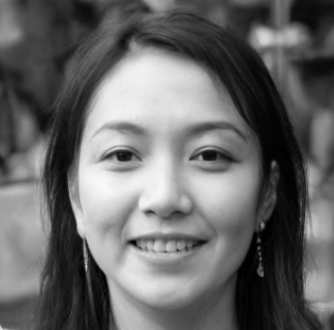
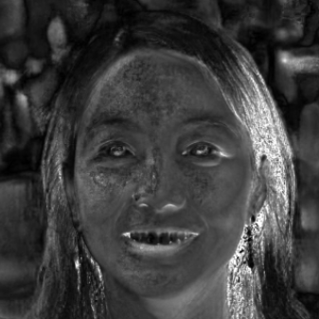
Introduction
Original
Hue
RGB HLS
HLS ：
hue（色調）
lightness（亮度）
saturation（飽和度）
Lightness
Saturation

Slide 4




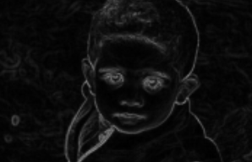
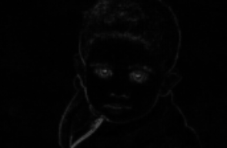
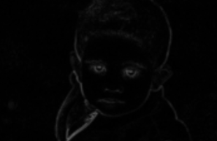
Sharpen
Original
Sobel
Laplacian
DFT

Slide 5
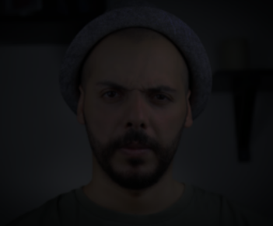
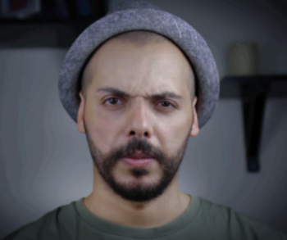
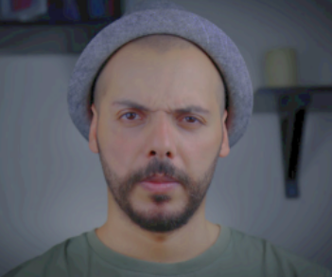
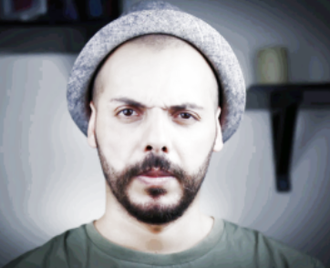
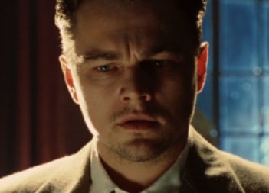
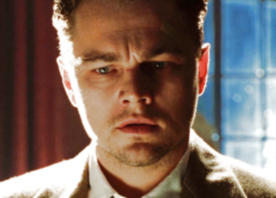
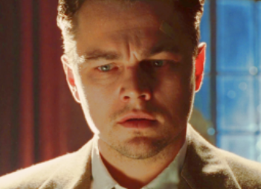
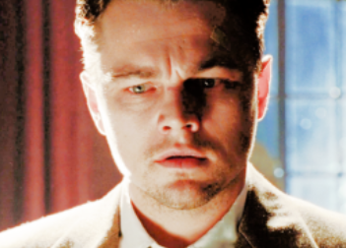
Image Contrast
Original
Log-transform
Power-law-transform
Histogram equalization

Slide 6


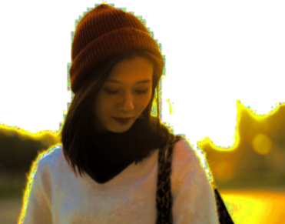
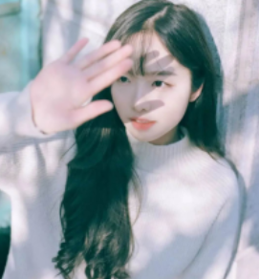
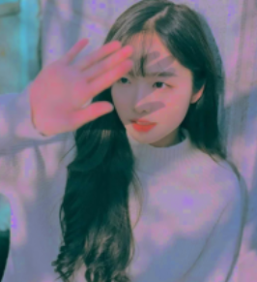
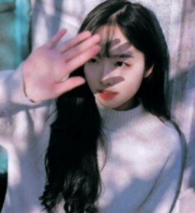
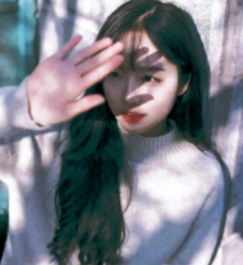
Image Contrast
Original
Power-law-transform
Histogram equalization
Original
Log-transform
Power-law-transform
Histogram equalization

Slide 7
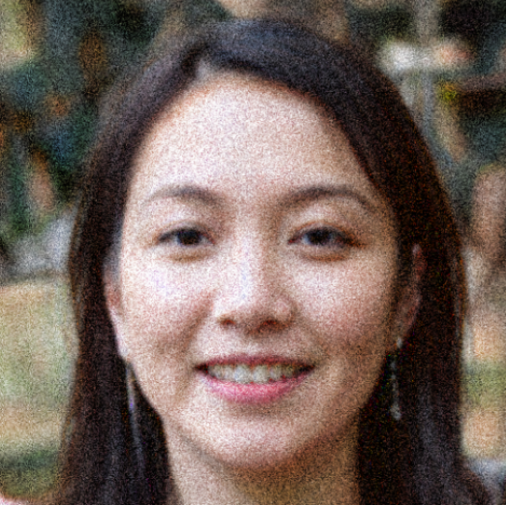
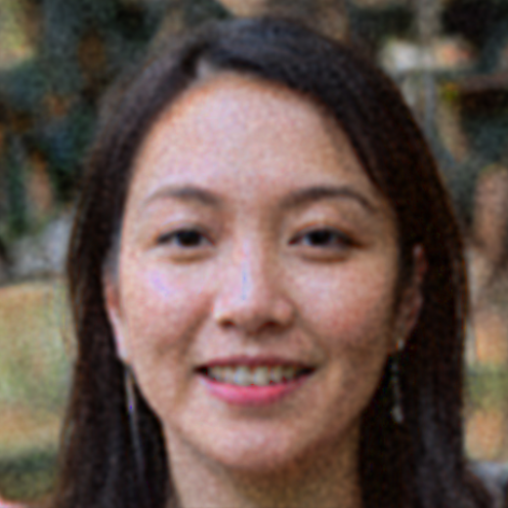
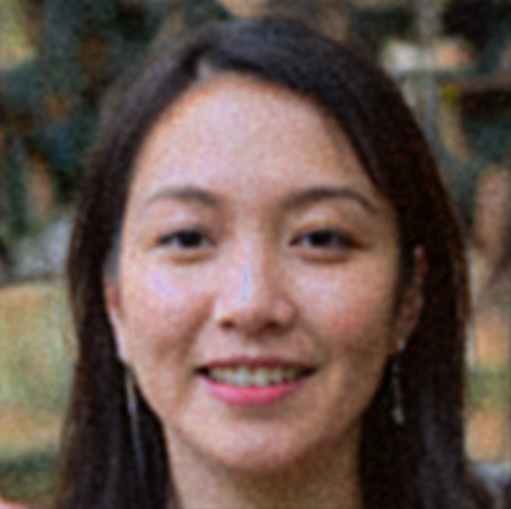
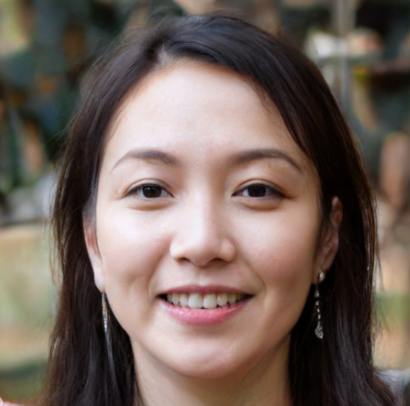
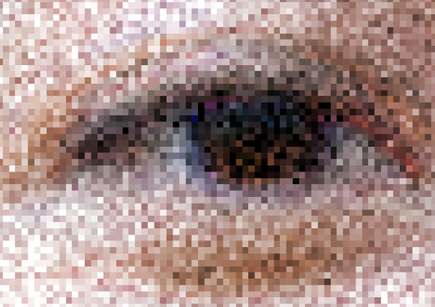
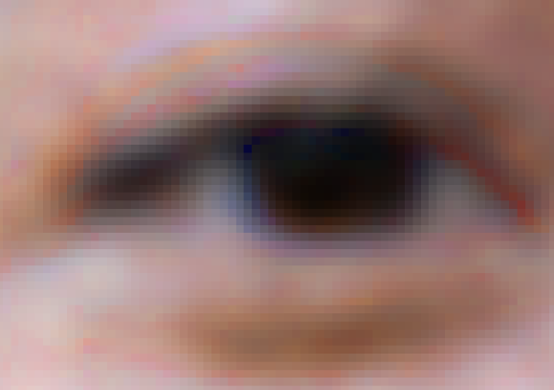
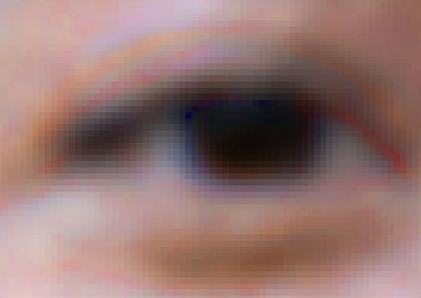
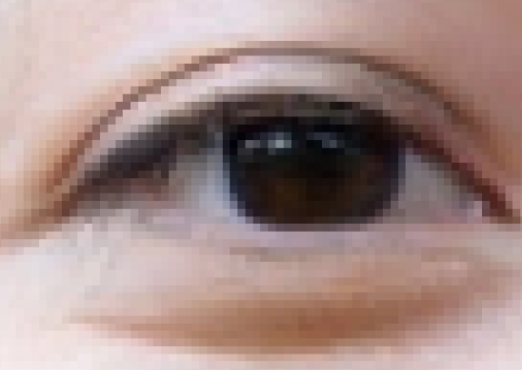
Deblur
Blur and Noise
Gaussian
Butterworth
Original

Slide 8
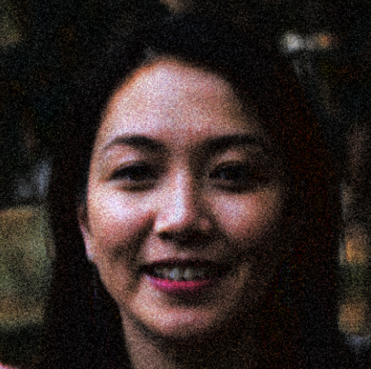
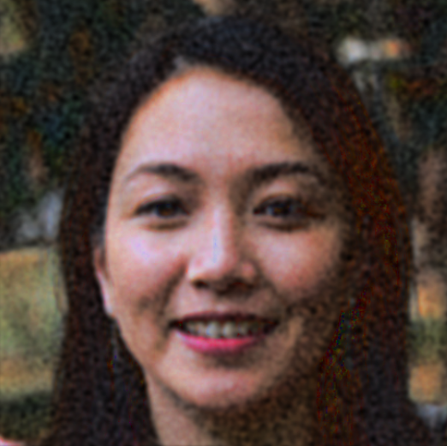


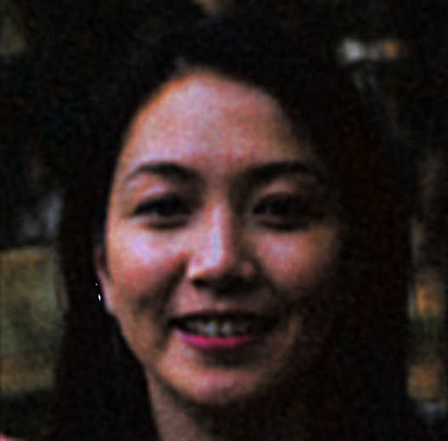
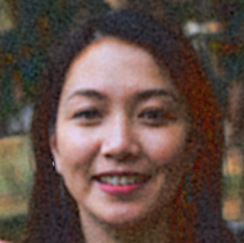
Deblur
Original
Contrast
Deblur
Deblur
Contrast

Slide 9
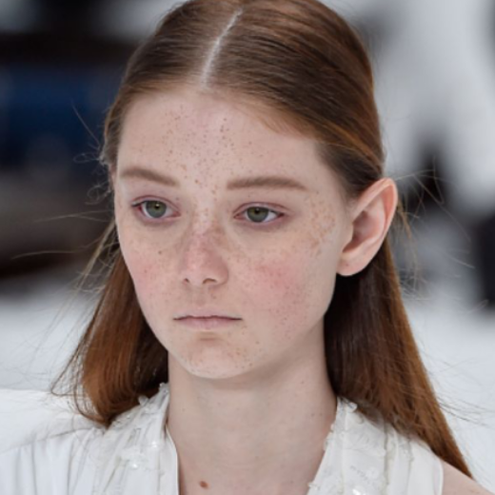




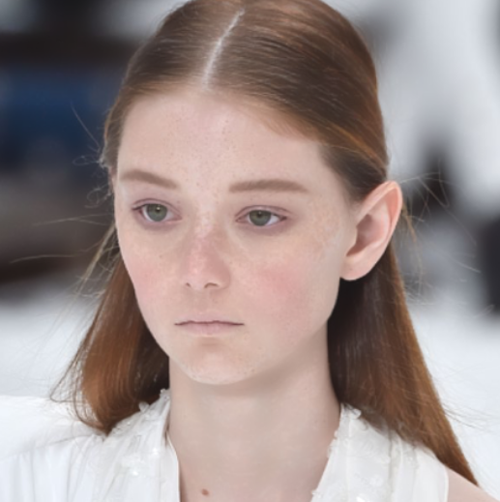
Denoise
Bilateral Filter：region(25*25)、sigma_color(25)、sigma_space(25)
Original
Bilateral
Bilateral and Sharp
Bilateral and Original
Bilateral and Original and Sharp
Internet

Slide 10
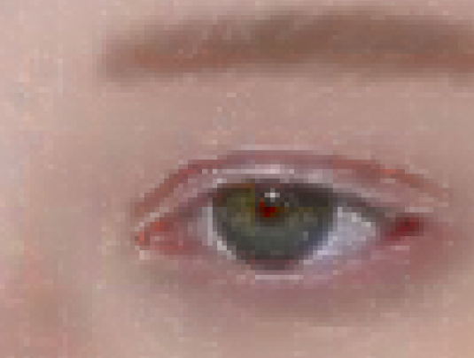
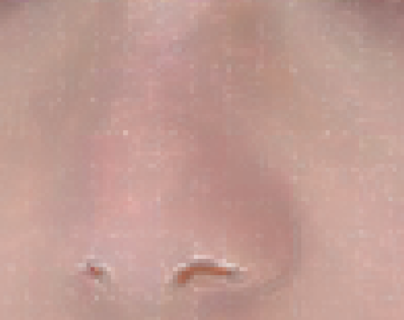
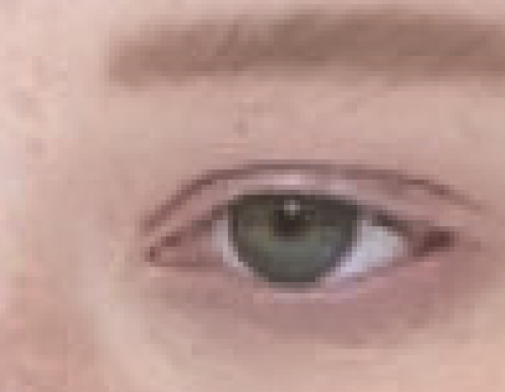
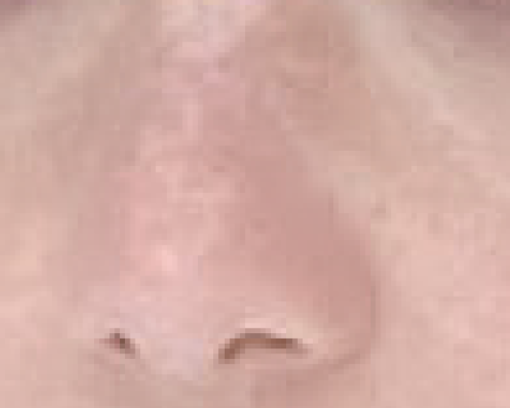
Denoise
Bilateral Filter：region(25*25)、sigma_color(25)、sigma_space(25)
Bilateral and Original and Sharp
Internet

Slide 11
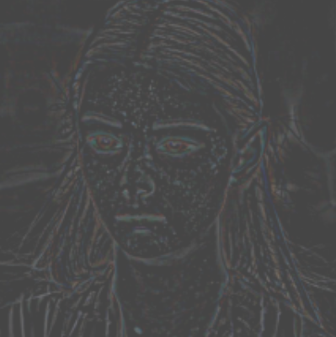
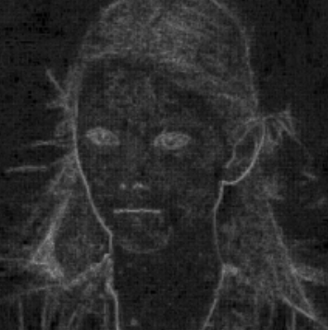
Denoise
Bilateral Filter：region(25*25)、sigma_color(25)、sigma_space(25)
Temp1 = Bilateral Filter(Original)
Temp2 = | Temp1– Original |
Temp3 = Gaussian_blur(Temp2)
Temp4 = Add_weighted(Temp3, Original)
Temp2
Laplacian filter

Slide 12
Thanks For Listening

